Slide 1
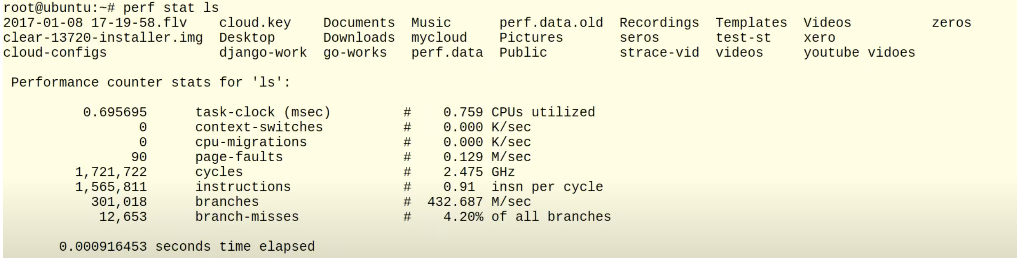
Perf
perf: Linux profiling with performance counters
Performance counters for Linux are a new kernel-based subsystem that provide a framework for all things performance analysis. It covers hardware level (CPU/PMU, Performance Monitoring Unit) features and software features (software counters, tracepoints) as well.
perf stat xxx
This command runs a command and gathers performance counter statistics from it.
perf record xxx
This command runs a command and gathers a performance counter profile from it, into perf.data - without displaying anything.
perf report –i perf.data
This command displays the performance counter profile information recorded via perf record.
perf trace ls
This command will show the events associated with the target, initially syscalls, but other system events like pagefaults, task lifetime events, scheduling events, etc.

Slide 2
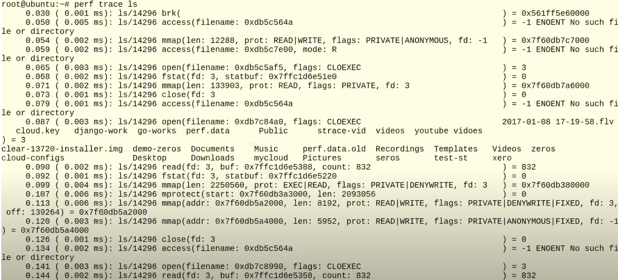
Perf
perf trace ls
This command will show the events associated with the target, initially syscalls, but other system events like pagefaults, task lifetime events, scheduling events, etc.
It trace and analyze system events and function calls in real-time.
It provides insights into the execution flow of a program or system, helping you understand the behavior and performance characteristics of the code.

Slide 3
libvirt
Libvirt is an open-source API (Application Programming Interface) and toolkit that provides a common interface for managing virtualization technologies, such as KVM (Kernel-based Virtual Machine), Xen, QEMU, LXC (Linux Containers), and more.
The primary goal of libvirt is to simplify the management and control of virtual machines (VMs) and virtualization resources. It provides a wide range of functionality, including creating, configuring, starting, stopping, and migrating VMs, managing storage and network resources, and accessing various virtualization features and capabilities.
Key features of libvirt include:
Hypervisor (virtual machine monitor) Independence: Libvirt abstracts the differences between various hypervisors, allowing management tools to interact with different virtualization platforms through a unified API. This enables developers and system administrators to write portable applications that can work with multiple virtualization technologies.
Extensibility: Libvirt offers a pluggable architecture, allowing support for new hypervisors and virtualization technologies to be added easily. It provides a modular framework where additional functionality, such as storage and network drivers, can be integrated.
Remote Management: Libvirt supports remote management of virtualization hosts, allowing you to control and monitor VMs across a network. This feature is particularly useful in virtualized environments with distributed or remote systems.
Language Bindings: Libvirt provides language bindings for several programming languages, including C, Python, Java, Ruby, and more. This makes it easier to develop virtualization management tools and applications using the language of choice.

Slide 4
psutil
psutil (process and system utilities) is a cross-platform library for retrieving information on running processes and system utilization (CPU, memory, disks, network, sensors) in Python. It is useful mainly for system monitoring, profiling and limiting process resources and management of running processes. It implements many functionalities offered by classic UNIX command line tools such as ps, top, iotop, lsof, netstat, ifconfig, free and others.
CPU
psutil.cpu_times(percpu=False)
Return system CPU times as a named tuple. Every attribute represents the seconds the CPU has spent in the given mode. The attributes availability varies depending on the platform
>>> psutil.cpu_times()
scputimes(user=3961.46, nice=169.729, system=2150.659, idle=16900.540, iowait=629.59, irq=0.0, softirq=19.42, steal=0.0, guest=0, nice=0.0)
cpu_percent(interval=None)
Return a float representing the process CPU utilization as a percentage which can also be > 100.0 in case of a process running multiple threads on different CPUs. When interval is > 0.0 compares process times to system CPU times elapsed before and after the interval (blocking). When interval is 0.0 or None compares process times to system CPU times elapsed since last call, returning immediately.
psutil.cpu_count(logical=True)
Return the number of logical CPUs in the system or None if undetermined. “logical CPUs” means the number of physical cores multiplied by the number of threads that can run on each core (this is known as Hyper Threading).
Memory
psutil.virtual_memory()
Return statistics about system memory usage as a named tuple including the following fields, expressed in bytes.
Disks
psutil.disk_usage(path)
Return disk usage statistics about the partition which contains the given path as a named tuple including total, used and free space expressed in bytes, plus the percentage usage.
Network
psutil.net_io_counters(pernic=False, nowrap=True)
Return system-wide network I/O statistics as a named tuple including the following attributes: bytes_sent, bytes_recv, etc.

Slide 5
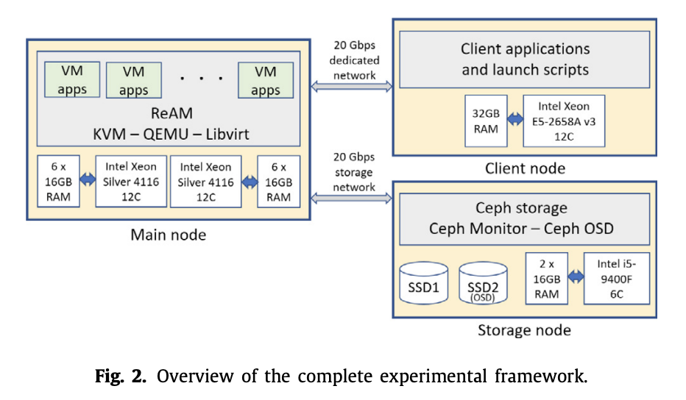
Introduction:
Performance Heterogeneity: Commonly used models show heterogeneous performance behavior across accelerator types due to various architectural differences. Existing schedulers like Gandiva, Tiresias, and Themis do not consider this heterogeneous performance behavior.
Generality across Policies: Cluster operators might want to implement different scheduling policies based on their business goals, such as optimizing for time to complete a set of batch jobs (makespan), fairness for ad-hoc jobs, or more sophisticated hierarchical policies that divide resources among high-level entities (e.g., departments) using one policy, and then individual jobs within the entity using another
Colocation and Placement Optimizations:
Cloud White: Detecting and Estimating QoS Degradation of Latency-Critical Workloads in the Public Cloud
This paper concentrates on the latter case, where two or more VMs are involved and the performance degrades due to the inter-VM interference. We use the terms victim and inflicting to refer to VM(s) suffering performance degradation and the VM(s) increasing its load, respectively.
The main goal of this paper is twofold: detect the victim VM(s) and estimate its performance degradation, both especially challenging when all the co-running applications are latency-critical in the public cloud.
Experimental setup:
With the aim of building a controlled environment closely resembling one of the public cloud, we set up an experimental platform following the structure depicted in Fig. 2. The three main components of the system are the physical server (main node), the client node, and the storage node, interconnected among them with two 20 Gbps dedicated links.
The server node is made up of two 12-core Intel Xeon Silver 4116 processors, with six memory channels holding 16 GB each, which amounts 96 GB (6 × 16 GB) of DRAM and supports a bandwidth of 107.3 GB/s. It has a 16.5 MB 11-way LLC, which supports Intel Resource Director Technologies (RDT) [22]. The installed operating system is Ubuntu 18.04 LTS. The main tasks carried out in the server node, performed under our Resource and Application Manager software (ReAM), are (1) run the VMs hosting the applications to be studied, (2) collect the data sampled, and (3) apply Cloud White. Data sampled include (i) hardware/software events gathered with the performance monitoring unit (PMU) using Perf [23,24], (ii) breakdown of the processor time from the /proc/stat system file, which reports statistics about the amount of time spent performing different kinds of work, and (iii) consumption of the main system shared resources not monitored with the PMU but with the support libraries offered by the developers of the tools. LLC occupancy and memory bandwidth are measured with Intel’s PQoS library [25]. Disk bandwidth is obtained with libvirt’s library [26]. Network bandwidth (both send and receive) is obtained with OVS-ofctl [27] commands, used to monitor and manage OpenFlow switches.
To replicate a typical cloud infrastructure, the experimental framework works with VMs that use KVM as hypervisor, QEMU as virtualizer, and libvirt as virtualization manager. This configuration is similar to that used by a compute node of OpenStack [28], which is currently used in production-system software [29].
Notes:
在计算出矩阵X后，Gavel使用一个基于轮询的调度机制为每个模型分配资源，在每一个round结束后，会根据X(m, j)/模型m在加速器j上已经分配的时间片计算优先级，根据优先级高低决定下一轮的资源分配：

Slide 6
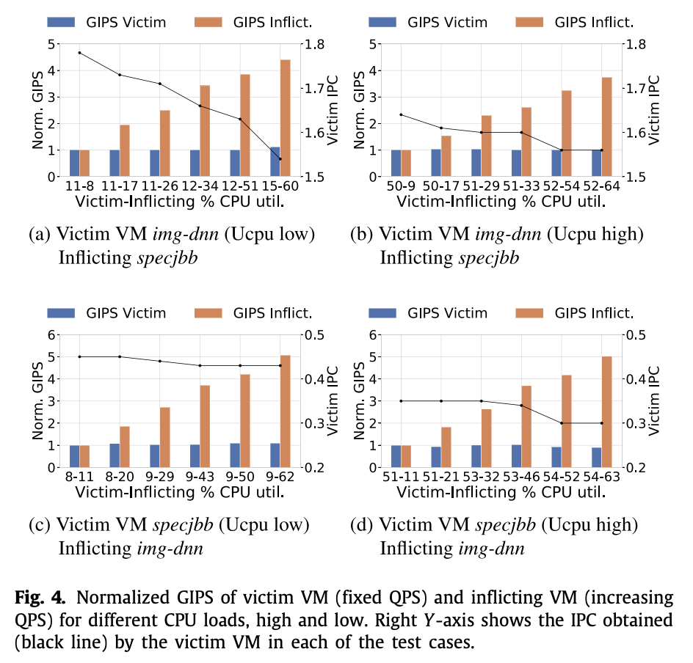
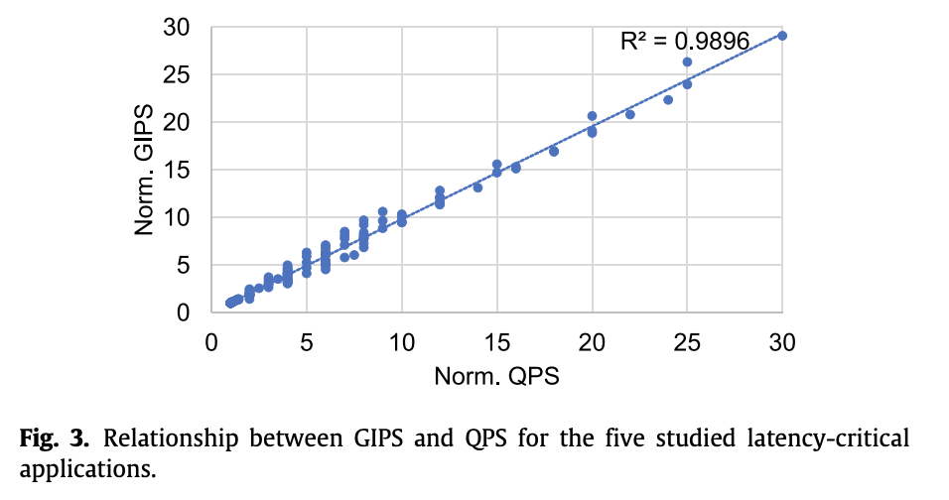
Introduction:
Performance Heterogeneity: Commonly used models show heterogeneous performance behavior across accelerator types due to various architectural differences. Existing schedulers like Gandiva, Tiresias, and Themis do not consider this heterogeneous performance behavior.
Generality across Policies: Cluster operators might want to implement different scheduling policies based on their business goals, such as optimizing for time to complete a set of batch jobs (makespan), fairness for ad-hoc jobs, or more sophisticated hierarchical policies that divide resources among high-level entities (e.g., departments) using one policy, and then individual jobs within the entity using another
Colocation and Placement Optimizations:
Cloud White: Detecting and Estimating QoS Degradation of Latency-Critical Workloads in the Public Cloud
This paper concentrates on the latter case, where two or more VMs are involved and the performance degrades due to the inter-VM interference. We use the terms victim and inflicting to refer to VM(s) suffering performance degradation and the VM(s) increasing its load, respectively.
The main goal of this paper is twofold: detect the victim VM(s) and estimate its performance degradation, both especially challenging when all the co-running applications are latency-critical in the public cloud.
4.2. Case study with two VMs:
System Overview:
4.1. GIPS: a new way to detect the victim and inflicting VMs
We found that the number of instructions executed per second helps identifying the inflicting and victim VMs. More precisely, the Giga Instructions executed Per Second (GIPS).
The amount of instructions committed by a VM per second is directly related to the number of queries that it receives per second (QPS). That is, if a victim VM keeps its load steady (i.e., the server processes the same requests per second), its GIPS remain unaffected. Otherwise, the GIPS will change.
To support this claim, we studied the correlation between QPS and GIPS.
IPC and GIPS are not directly correlated since IPC is calculated over the time the CPU is busy (i.e., utilization time) while the GIPS is computed over the total measurement time, which comprises both the utilization time and time the VM is waiting for client requests.
as the normalized GIPS of the inflicting VM (orange bar) grows in a by 4× factor in the highest interference. On the contrary, the GIPS of the victim VM (blue bar) remain around 1 across the six experiments in the plot. The interference introduces an important change in the victim behavior. The CPU utilization grows from 11% to 15% when it works under low load (left side plot) and from 50% to 52% (right side plot). This represents an important growth (in percentage), especially under low load conditions, thus it translates into significant performance losses. Notice that the IPC of the victim VM (right Y-axis) significantly decreases as the interference increases, dropping from around 1.78 to 1.53.
Notes:
在计算出矩阵X后，Gavel使用一个基于轮询的调度机制为每个模型分配资源，在每一个round结束后，会根据X(m, j)/模型m在加速器j上已经分配的时间片计算优先级，根据优先级高低决定下一轮的资源分配：

Slide 7
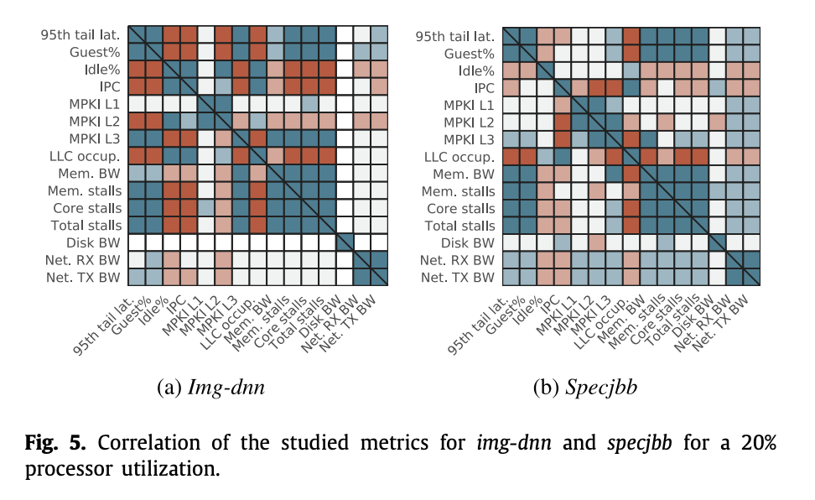
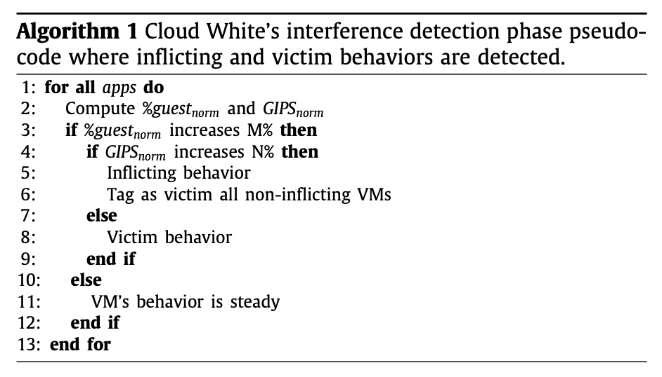
Introduction:
Performance Heterogeneity: Commonly used models show heterogeneous performance behavior across accelerator types due to various architectural differences. Existing schedulers like Gandiva, Tiresias, and Themis do not consider this heterogeneous performance behavior.
Generality across Policies: Cluster operators might want to implement different scheduling policies based on their business goals, such as optimizing for time to complete a set of batch jobs (makespan), fairness for ad-hoc jobs, or more sophisticated hierarchical policies that divide resources among high-level entities (e.g., departments) using one policy, and then individual jobs within the entity using another
Colocation and Placement Optimizations:
Cloud White: Detecting and Estimating QoS Degradation of Latency-Critical Workloads in the Public Cloud
4.3. Cloud White: Interference detection phase algorithm:
Algorithm 1 presents the pseudo-code of the interference detection mechanism performed by Cloud White. That is, the steps carried out to discern if a given VM present an inflicting or a victim behavior.
First, the normalized load and GIPS are computed for each application. Normalized values are computed with respect to No Interference scenario
Load is quantified in terms of percentage of guest time (the percentage of time process in VM runs)
Once computed, Cloud White checks if the VM has experienced a load change. This is done by checking if %guest time has changed – increase or decrease – more than a given threshold (M%) over the rolling mean of the previous intervals.
If this condition fulfills, then it checks if the GIPS have also noticeably changed (over N%). In such a case, the VM is tagged as inflicting.
Otherwise, it is tagged as victim. Notice that some VMs may not experience any load change (lines 10–11). However, if one of the co-located VM(s) exhibits an inflicting behavior, the VMs exhibiting a steady behavior are also tagged as victim as they may be possibly affected in the near-future by the interference caused by the inflicting VM(s). (even if a VM appears to be stable at a given moment, it may be at risk of being affected by the interference caused by other VMs.)
6. Cloud White: Modeling performance degradation:
This analysis is aimed at identifying the metrics that have stronger relationship with performance degradation in order to consider them in the prediction models.
The devised models are generic and can be applied to other applications showing similar characteristics. To check this claim, we make two different groups of workloads: one for building the models (known workloads) and another for evaluating the models (unknown workloads), not previously used.
6.1. Looking for performance metrics as model parameters
No performance degradation was observed due to the interference in the network bandwidth.
Notes:
在计算出矩阵X后，Gavel使用一个基于轮询的调度机制为每个模型分配资源，在每一个round结束后，会根据X(m, j)/模型m在加速器j上已经分配的时间片计算优先级，根据优先级高低决定下一轮的资源分配：

Slide 8
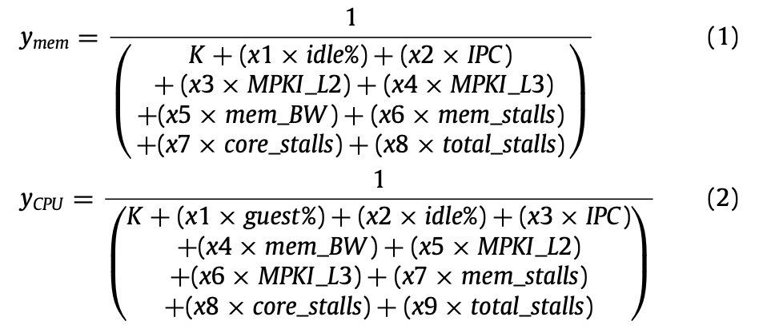
Introduction:
Performance Heterogeneity: Commonly used models show heterogeneous performance behavior across accelerator types due to various architectural differences. Existing schedulers like Gandiva, Tiresias, and Themis do not consider this heterogeneous performance behavior.
Generality across Policies: Cluster operators might want to implement different scheduling policies based on their business goals, such as optimizing for time to complete a set of batch jobs (makespan), fairness for ad-hoc jobs, or more sophisticated hierarchical policies that divide resources among high-level entities (e.g., departments) using one policy, and then individual jobs within the entity using another
Colocation and Placement Optimizations:
Cloud White: Detecting and Estimating QoS Degradation of Latency-Critical Workloads in the Public Cloud
6.2. Relationship between system load and the models:
To acquire a sound knowledge about the performance-related metrics (see Section 6.1), we analyzed how each metric individually correlates with performance degradation using regression models. We found that none of them strongly correlate with performance in a generalized way. Therefore, we looked into multi-variable regression models to devise models that achieve a stronger correlation. These models pursue to improve the correlation by combining several metrics.
we looked into models that do not require the data to be normally distributed. Among these, we found that the generalized linear models (GLM) [42] are the most appropriate for non-linear and skewed distributions [43].
The models were built and fitted using statsmodel Python library [41]. The model fitting was performed with the iteratively reweighted least squares (IRLS) method, with the objective of minimizing the deviation that occurs when estimating performance degradation.
Notes:
在计算出矩阵X后，Gavel使用一个基于轮询的调度机制为每个模型分配资源，在每一个round结束后，会根据X(m, j)/模型m在加速器j上已经分配的时间片计算优先级，根据优先级高低决定下一轮的资源分配：

Slide 9
Perf/libvirt/psutil overhead?
Hardware Support: perf takes advantage of hardware features and optimizations provided by modern processors. For example, it may utilize features like Performance Monitoring Units (PMUs), which are hardware components specifically designed for performance monitoring and profiling. These hardware features enable perf to collect performance data with minimal impact on the overall system performance.
Sampling: Instead of instrumenting every single event or instruction, perf uses sampling to collect performance data. Sampling involves periodically interrupting the program execution and recording the state of the system at that point. By sampling at regular intervals, perf can estimate the overall behavior of the program without the need to monitor every single event continuously. This significantly reduces the overhead associated with collecting performance data.
﻿ Perf/libvirt/psutil sample rate & granularity restriction/limitation?
The limit of the Perf sample rate, also known as the sampling frequency or sampling interval, depends on various factors, including the performance monitoring hardware capabilities, the configuration of the Perf tool, and the system workload.
In general, the Perf sample rate determines how frequently Perf collects performance samples. A higher sample rate allows for more detailed and accurate performance data but may incur higher overhead and resource utilization.
The smallest interval that perf can sample, also known as the minimum sample period or sampling resolution, depends on several factors, including the version of perf, the hardware capabilities, and the configuration of the system. You can experiment with different sample intervals and observe the resulting behavior and accuracy in your specific use case.
In recent versions of perf, such as perf from the Linux kernel version 4.9 onwards, the default value for the sampling interval is 1 ms (milliseconds). However, perf allows for finer-grained control over the sampling interval through the --freq or --period options.
The default minimum sample period supported by perf is 1 microsecond (µs), which is equivalent to 0.001 milliseconds (ms). This means that you can specify a sample interval as small as 1 microsecond when using perf commands.

Slide 10
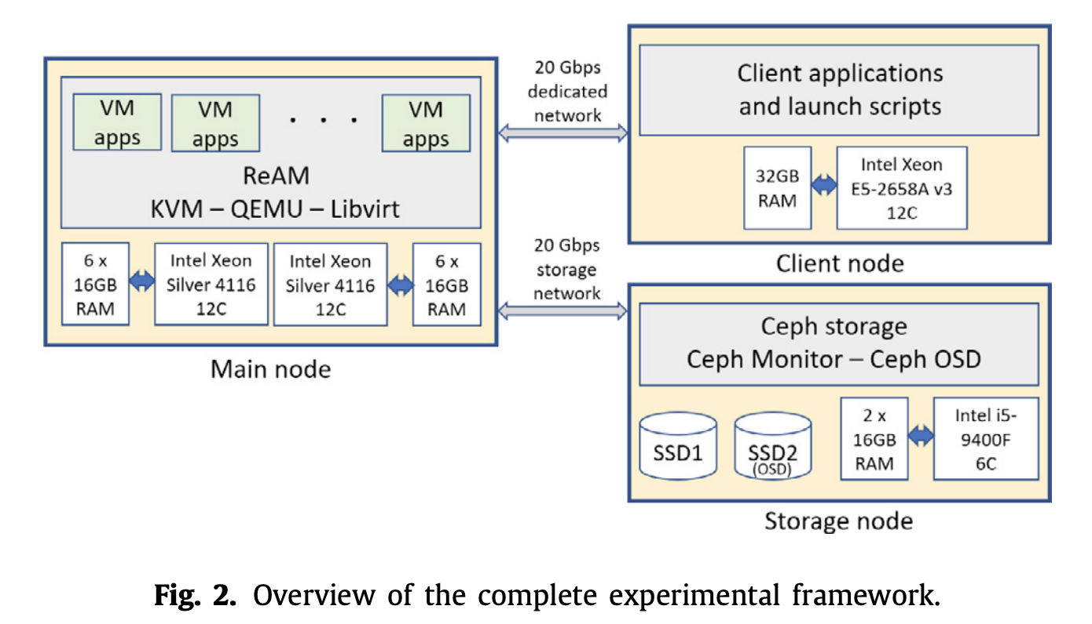
ReAM vs libvirt
The main tasks carried out in the server node, performed under our Resource and Application Manager software (ReAM), are (1) run the VMs hosting the applications to be studied, (2) collect the data sampled, and (3) apply Cloud White.
To replicate a typical cloud infrastructure, the experimental framework works with VMs that use KVM as hypervisor, QEMU as virtualizer, and libvirt as virtualization manager. This configuration is similar to that used by a compute node of OpenStack [28], which is currently used in production-system software [29].

Slide 11
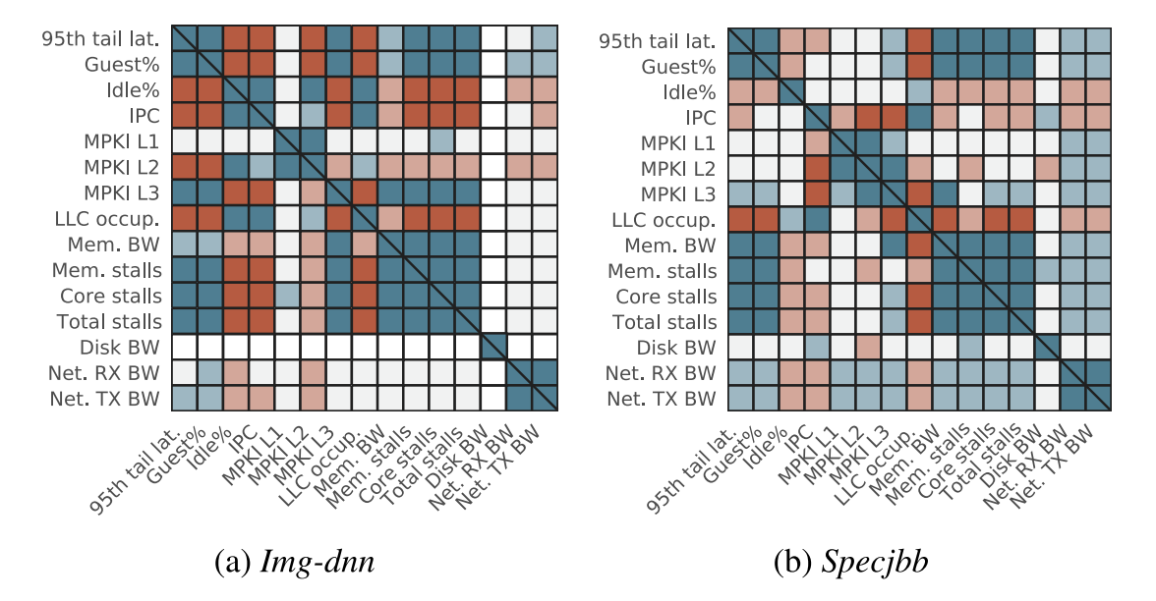
﻿ Variable from tools/manipulated?
Guest %:
percentage of guest time. perf can be used to get the percentage of guest time. The percentage of guest time refers to the amount of time spent by a virtual machine (guest) running on a hypervisor (host). It indicates the portion of CPU time allocated to the guest machine.
Idle %:
percentage of idle time. Use perf sample a duration (1s) to get the number of cycles used and the total cycles, then we can compute the idel % by (Total Cycles - Used Cycles) / Total Cycles * 100
IPC:
Instructions Per Cycle. perf stat -e instructions,cycles <your-command> to get the number of instructions and the number of cycles. Calculate IPC by dividing the number of instructions by the number of cycles
MPKI (Misses Per Kilo-Instructions) L1, L2, L3:
perf stat -e cache-misses,cache-references,instructions <your-command>
Divide the number of L1/L2/L3 cache misses by the number of instructions and multiply by 1000.
LLC occup.:
perf stat -e LLC-loads,LLC-load-misses <your-command>
LLC Occupancy = (1 - (LLC Load Misses / LLC Loads)) * 100
Mem BW:
perf stat -e mem-loads,mem-stores <your-command>
Mem stalls:
perf stat -e mem-stalls <your-command>
Core stalls:
perf stat -e cpu-cycles -e stalled-cycles-frontend -e stalled-cycles-backend <your-command>
Disk BW:
It's important to note that libvirt provides the interface to manage virtualization resources and retrieve information about virtual machines, but the actual monitoring of disk bandwidth typically relies on external tools and utilities, such as iostat, iotop, or bwm-ng. The exact steps and commands may vary depending on your specific setup, virtualization technology, and operating system.
Net. RX BW (Network Receive Bandwidth) & Net. TX BW (Network Transmit Bandwidth):
Monitored using command line.

